Slide 1

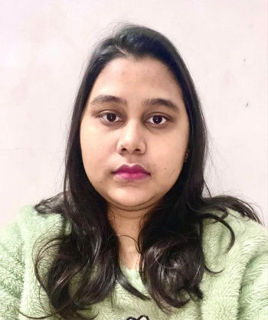





Ambika Soni
Education and certificates
Bachelor of Technology Computer Science : 2015 - 2019
Analyst/Software Engineer
Base Location: ^{Mumbai}
Skills
MS office
HTML
CSS
.Net
Analytical skill
Email ID:
Ambika.a.soni@capgemini.com
_{Mobile No:} +91 8299879069
Grade:
A4
Database
SQL database – MySQL
Strengths
A self driven learner who is passionate about implementing and launching new projects.
Ready to learn new technologies and implement them to further improve my knowledge.
A team player with good communication skill always ready to work for the enrichment of knowledge.
Experience
Capgemini, Mumbai (Apr 2022-Current)
Analyst/Software Engineer
Additional Details
Excellent Communication Skills
Team Player
Aalacom Technology, Noida (Aug 2021-Feb 2022)
Recruiter
Involve in end to end recruitment
Sourcing resume from job portals
Understanding the IT Requirements
Pre-screening, telephonic interviews, scheduling
Talent Topper, Noida (Jan 2021-Aug 2021)
Recruiter
Involve in end to end recruitment
Sourcing resume from job portals
Understanding the IT Requirements
Pre-screening, telephonic interviews, scheduling
Check out my work on GitHub & Video Profile
Presentation Title | Author | Date © Capgemini 2017. All rights reserved | 1

